Slide 1
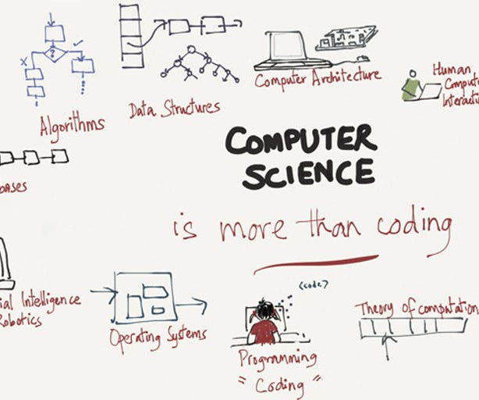

Slide 2
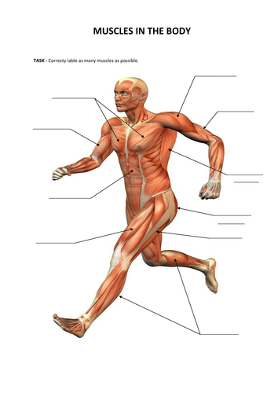
https://youtu.be/Z_S2uRjLZ14 computer science
Phsycially allow students to model what the character on the screen is going to do (i.e. move in a circle, move left, move right, etc.)
Have students switch between driver and navigator mode in paired programming.
Materials like Hands-On Coding Blocks are helpful for planning out computer science projects.
Allow students to stand while working or sit on flexible furniture
Allow students to draw or physically model what the character on the screen is going to do (i.e. move in a circle, move left, move right, etc.)
Have students switch between driver and navigator mode in paired programming.
Allow students to hand write instructions or information as needed

Slide 3
